Slide 1


LOYOLA – ICAM COLLEGE OF
ENGINEERING AND TECHNOLOGY (LICET)
(AUTONOMOUS)
LOYOLA CAMPUS, NUNGAMBAKKAM , CHENNAI – 34
DEPARTMENT OF COMPUTER SCIENCE ENGINEERING
MERN Stack Powered by MongoDB
Online Learning Platform
Team No: 9802
Team Members Details:
Fathima Zulaikha – 311121104022
Diana Jose – 311121104016
Tony Infant P – 311121104061
Mohanaselvan M K - 311121104039

Slide 2
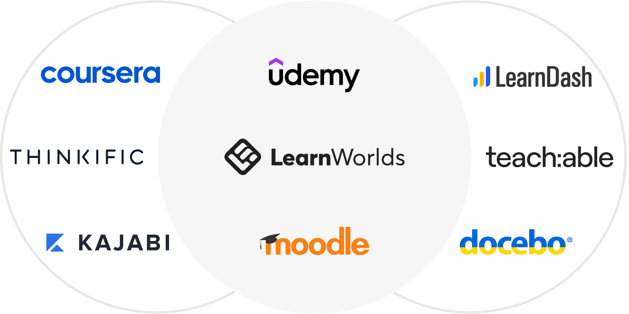
Problem Statement
An online learning platform (OLP) is a digital platform that provides a variety of tools and resources to facilitate learning and education over the internet.
These platforms have become increasingly popular, especially in recent years, as they offer flexibility and accessibility for learners of all ages and backgrounds
Focused on security, scalability, and responsive design, the system enhances user satisfaction and simplifies online learning.

Slide 3
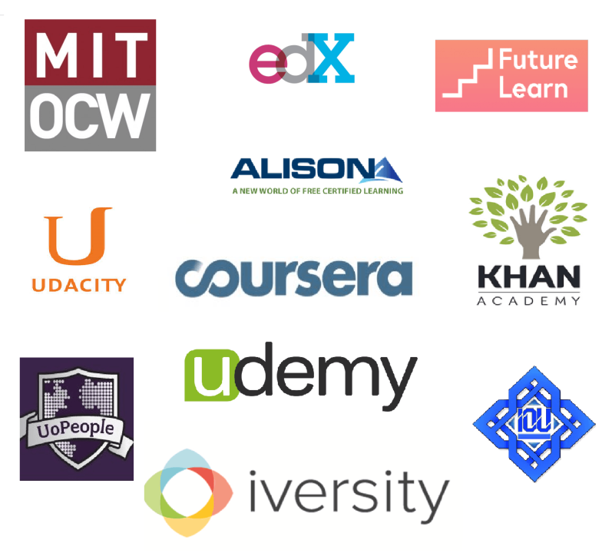
Solution
Enhanced Learning Experience: Learners can browse courses, enroll, and access materials effortlessly through an intuitive and responsive interface.
Efficient Course Management: Instructors manage courses using secure CRUD functionality to create, update, or remove content, ensuring up-to-date learning resources.
Secure and Scalable Architecture: Built using the MERN stack, the platform ensures robust data security, scalability, and performance to handle a growing number of users and courses.
Flexible and Accessible Learning: The platform supports self-paced learning with seamless accessibility across devices, enabling learners to study anytime, anywhere.
Efficient Admin Management: Admins have secured and streamlined tools to manage courses, monitor instructor activities, and oversee student progress, ensuring smooth platform operations.

Slide 4

Features
User Features:
User Registration and Authentication.
Course Browsing and Search.
Course Enrollment and Progress Tracking.
Recommendations and Top Courses.
Admin Features:
Course Management (add, update, or delete courses).
Instructor and Student Account Management.
Review and Approval of Course Content.
Usage Monitoring.
Application-Wide Features:
Responsive Design for Seamless Access.
Content Management for Easy Updates.
User Authentication and Data Security.

Slide 5
Tech Stack
MERN Stack: MongoDB, Express.js, React.js, Node.js
MongoDB: A NoSQL database that stores data in flexible, JSON-like documents, enabling scalability and high performance.
Express.js: A lightweight, fast, and flexible Node.js web application framework for building APIs and web applications.
React.js: A JavaScript library for building dynamic, interactive user interfaces efficiently with reusable components.
Node.js: A JavaScript runtime for building fast, scalable server-side and networking applications.

Slide 6
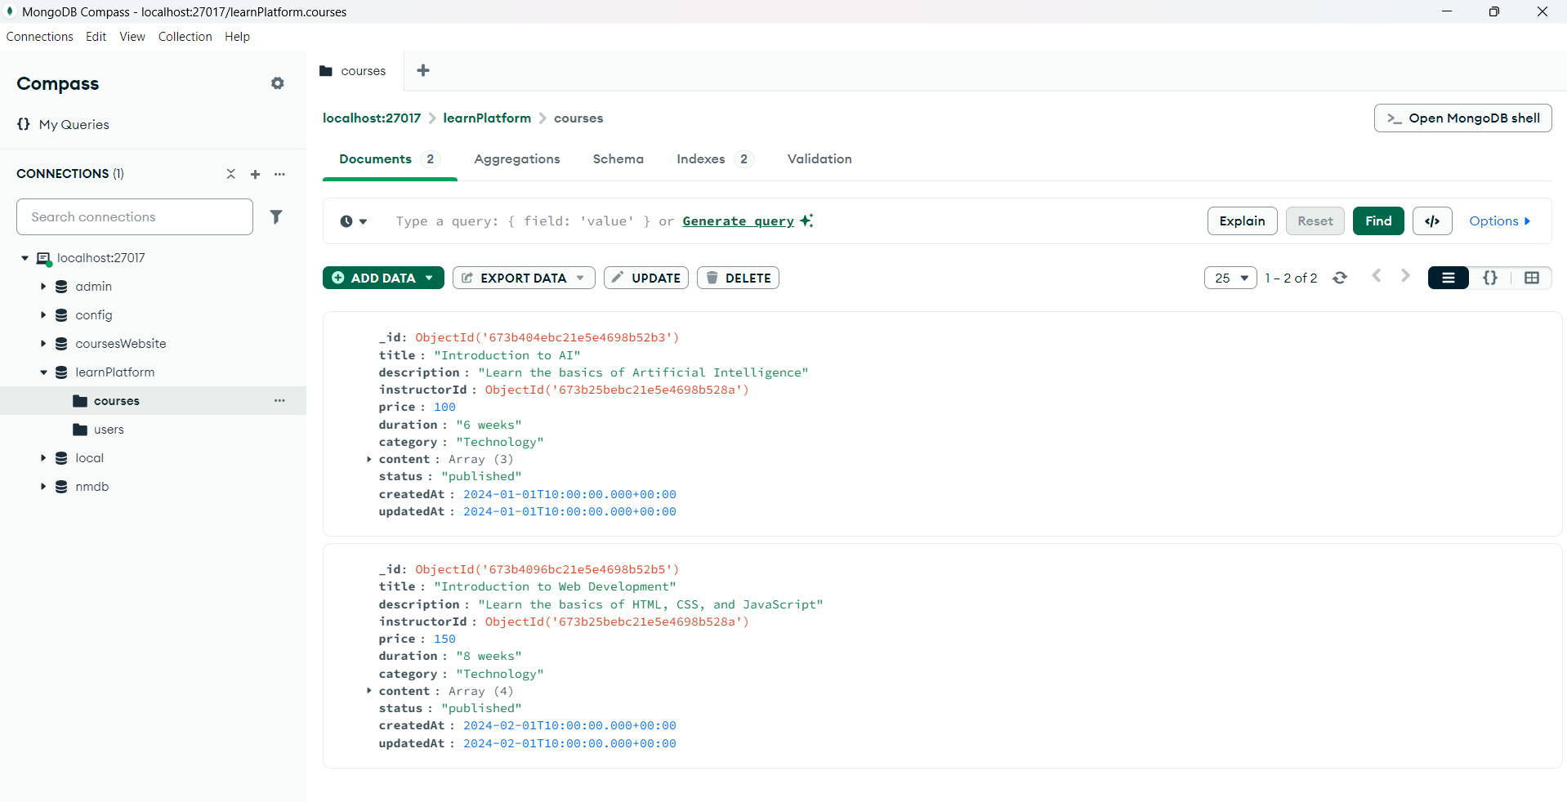
Screenshots
MONGODB ATLAS

Slide 7
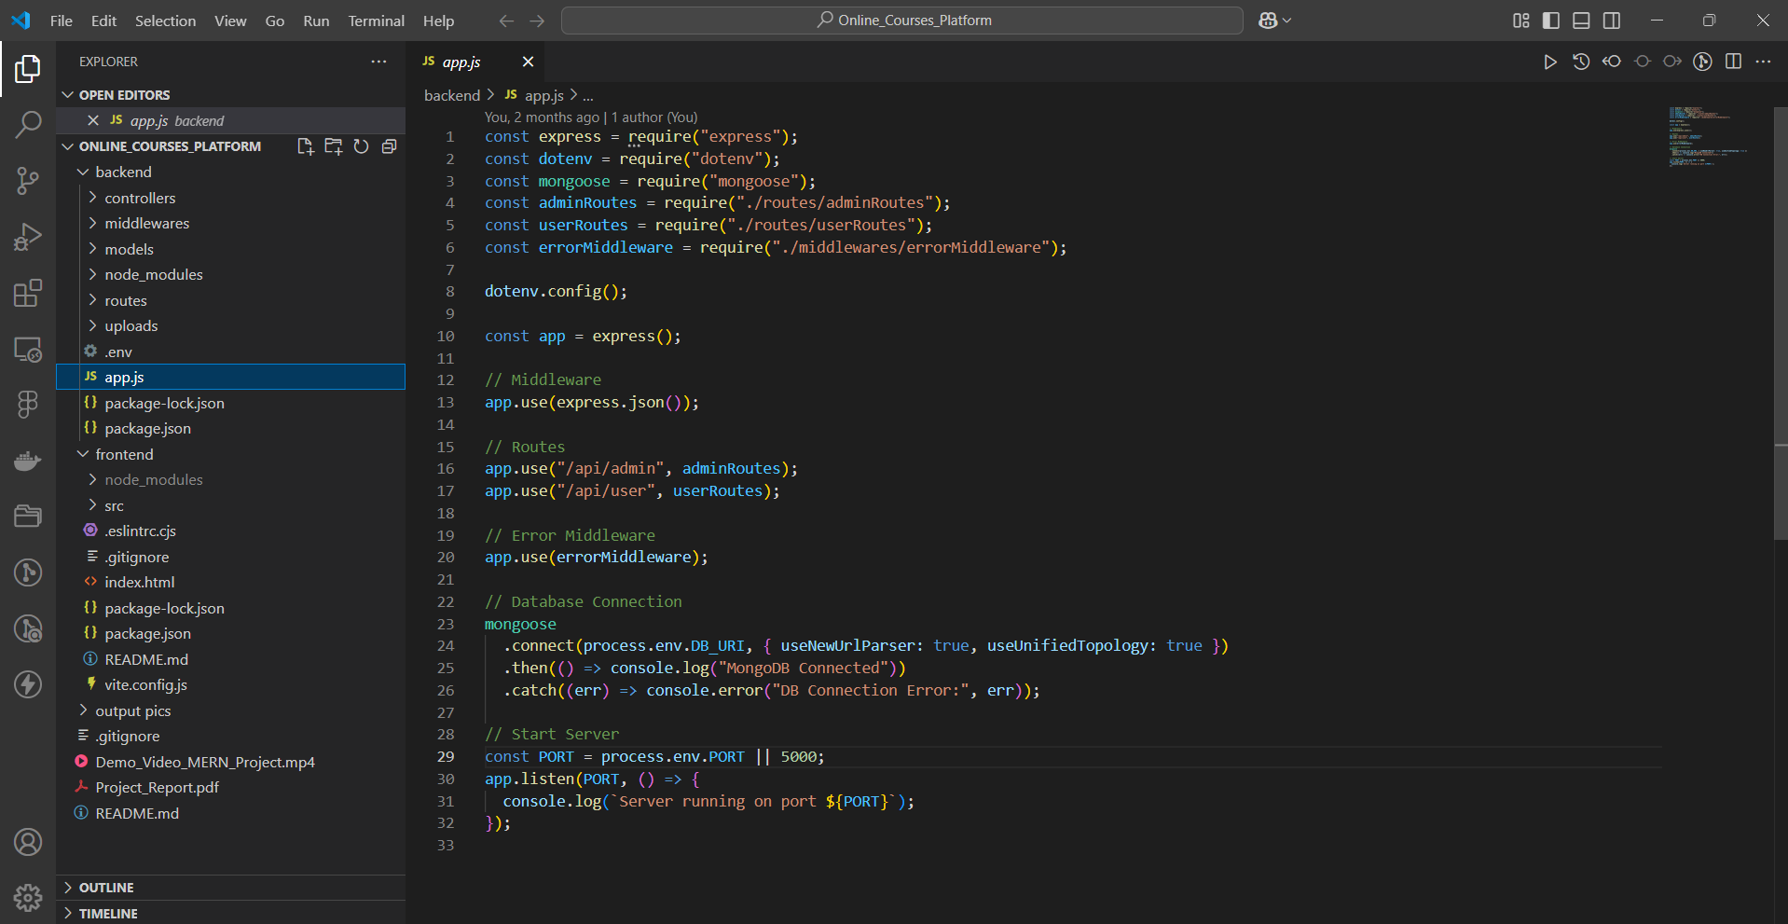
Screenshots
VS CODE

Slide 8

Screenshots
Home Page

Slide 9
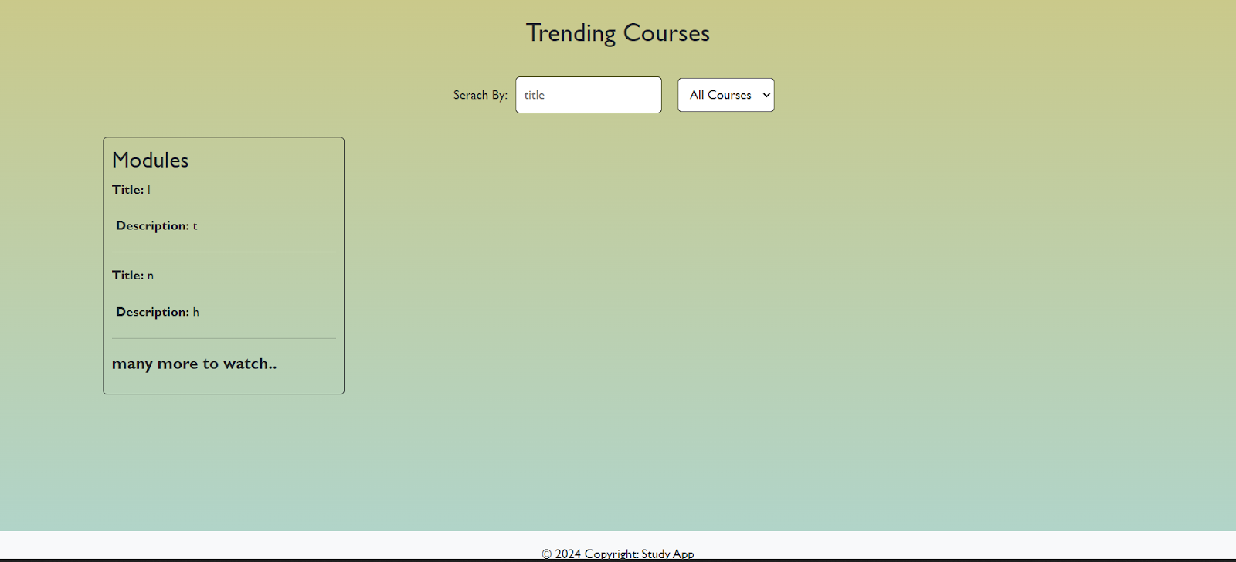
Screenshots

Slide 10
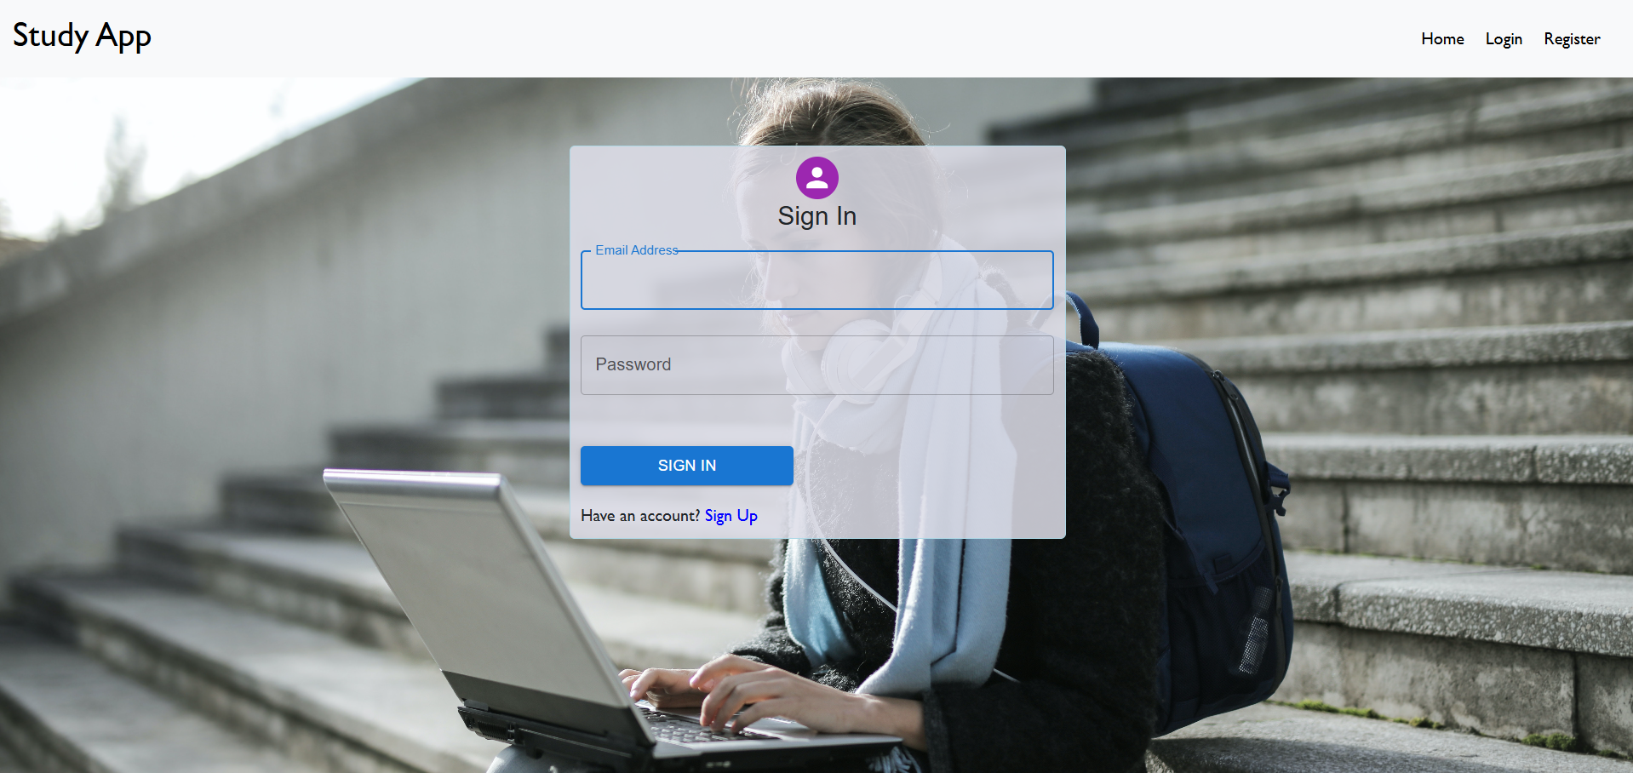
Screenshots
Login Page

Slide 11
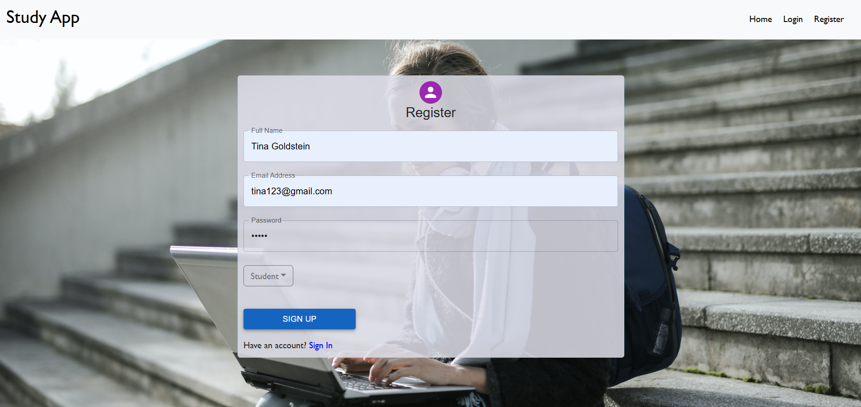
Screenshots
Register Page (Student)

Slide 12
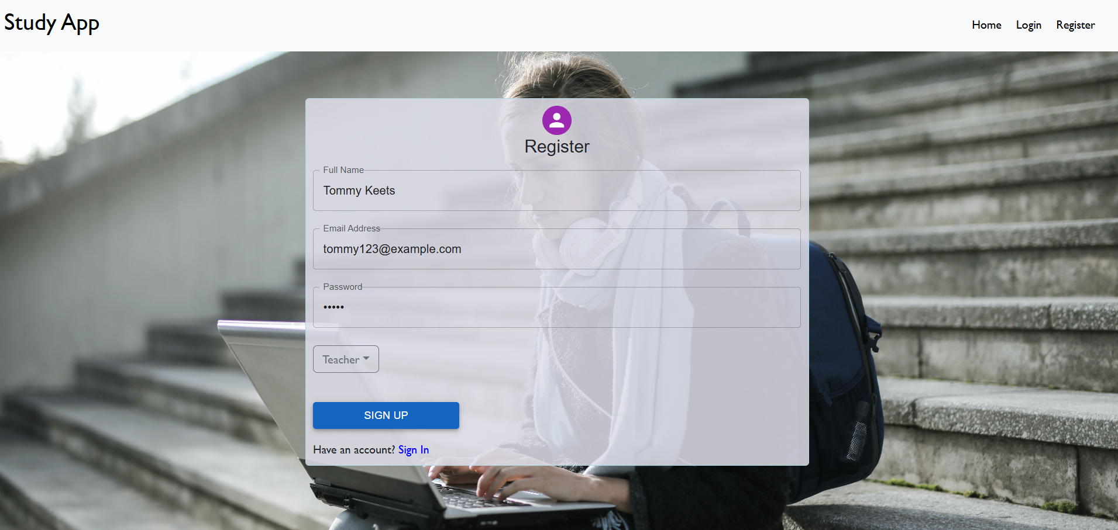
Screenshots
Register Page (Teacher)

Slide 13
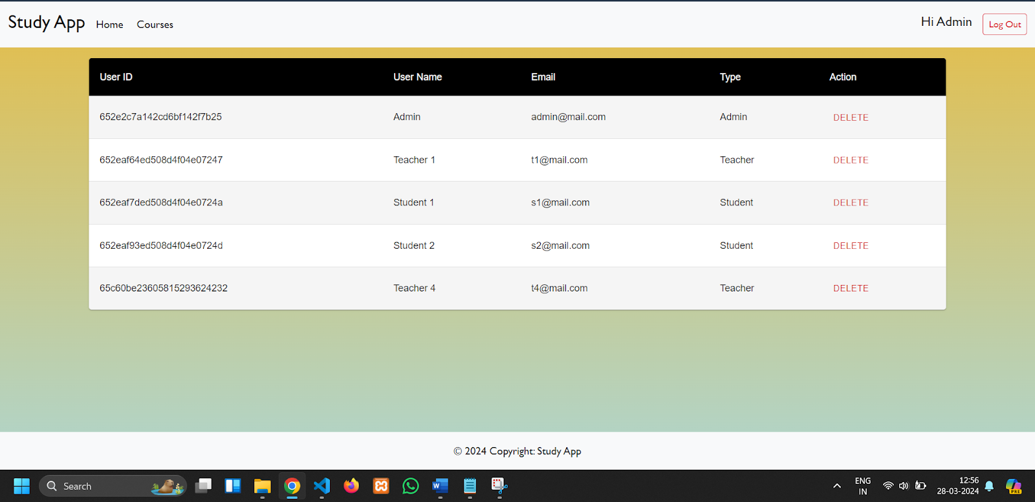
Screenshots
Admin Dashboard

Slide 14
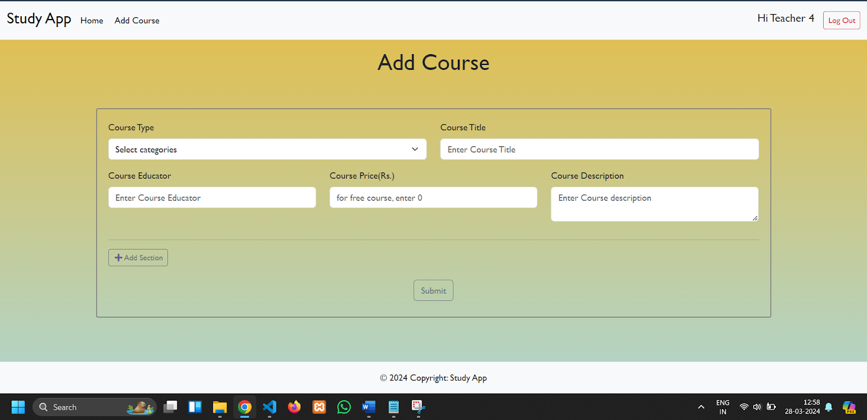
Screenshots
Teacher Dashboard

Slide 15
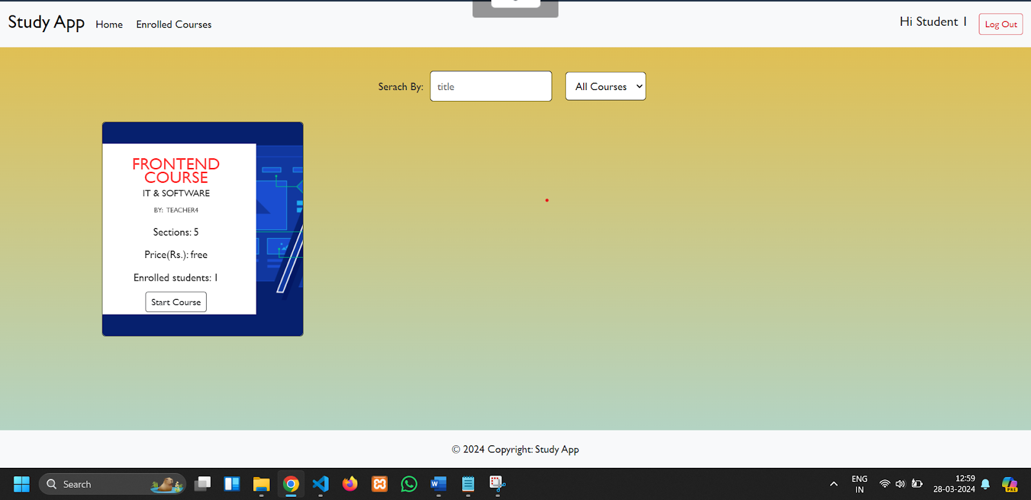
Screenshots
Student Dashboard

Slide 16
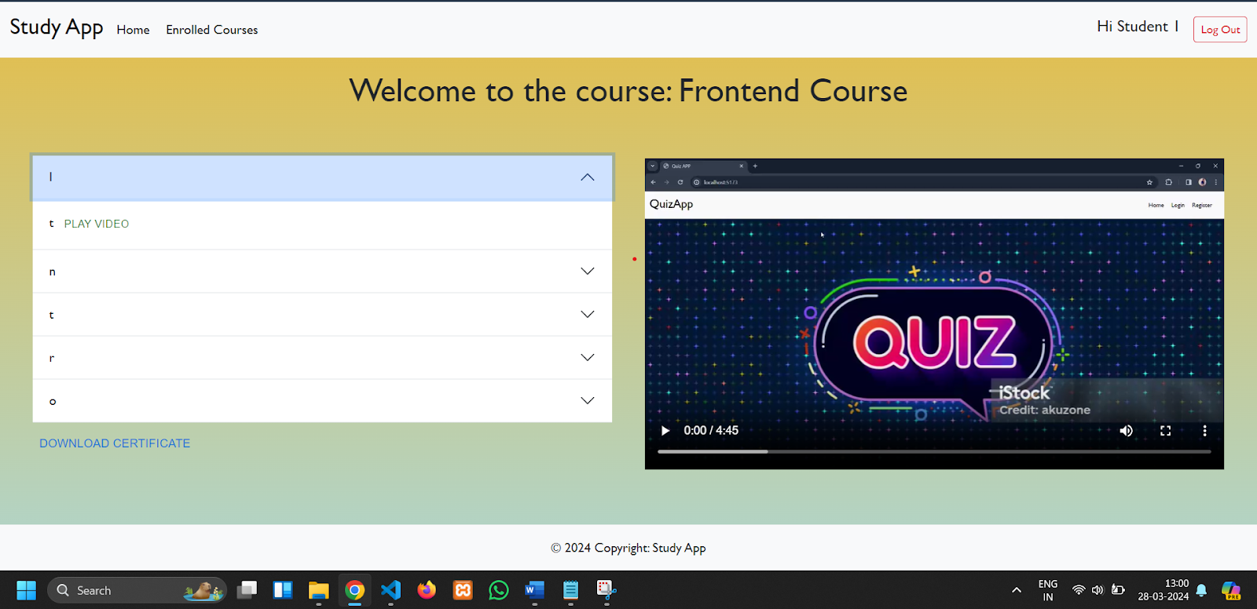
Screenshots
Course Dashboard

Slide 17
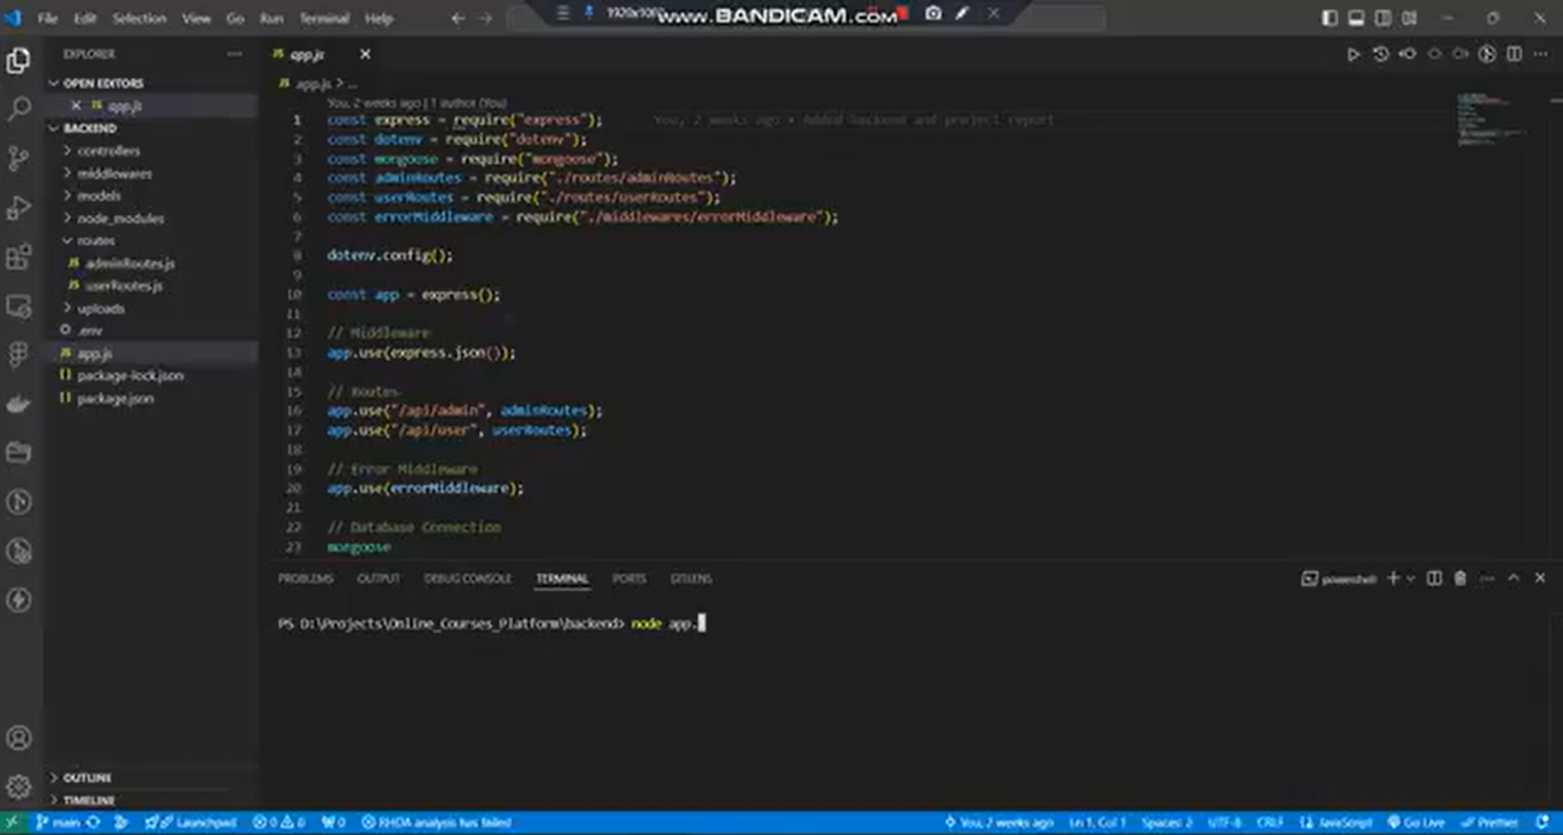
Demonstration
==== DEMO VIDEO ====
==== GitHub Link ====

Slide 18
Team Details
FATHIMA ZULAIKHA - 31F436356AD5E2CA1074371BA272A91E
DIANA JOSE - C9BBA07641040C58B6245909008EC8B5
TONY INFANT P - 23E186BA2BF38E3AFD6479BE58BA63C9
MOHANASELVAN M K - FFCF10F3C9E4BE8B80E4D09D5BFD1B94

Slide 19
Thank You !

